Slide 1
Kiln Optimization – Case Study
Technical Development Program SPREAD 2016

Slide 2
Goals of the Study, Key Learnings
Participants can assess “Critical Process Parameters” e.g. temperatures in preheater, hotmeal composition
Participants can calculate and assess “Process Analysis Indicators” e.g. kiln loads and critical velocities
Participants can apply combustion engineering calculations
2

Slide 3
Goals of the Study, Key Learnings
Participants can assess “Critical Process Parameters” e.g. temperatures in preheater, hotmeal composition
Participants can calculate and assess “Process Analysis Indicators” e.g. kiln loads and critical velocities
Participants can apply combustion engineering calculations
Participants are familiar with the optimization procedure:
1. Analysis & assessment of actual situation (where are we now?)
5. Implementation (just do it!)
2. Gap analysis (where should we be?)
4. Find and decide on improvement measures (how can we get there?)
3. Identification of bottlenecks / weak points (why are we not there?)
3

Slide 4
Organization of the Case Study
Case study simulates two production years
For each production year the groups will work during approx. 75 min on the following tasks
Read documents (15’)
Analysis and assessment of situation (30’)
Search for weak points/bottlenecks (15’)
Decide improvement measures (15’)
It is important that the group gets organized at the beginning – distribution of work inside group
The results for each production year will be presented after termination of the group work
4

Slide 5
Schedule
08:30 Introduction year 1 20’
08:50 Work Year 1 60’
09:50 Discussion of results 15’
10:05 Coffee break 25’
10:30 Introduction year 2 10’
10:40 Group work 60’
11:40 Discussion of results 15’
Year 1
Year 2
5

Slide 6
Introduction (I)
Each team plays the role of the Process Performance Engineer at the „Dandelion" cement plant operated by Holcim Meadow Ltd.
Plant is equipped with one 4 stage DOPOL preheater kiln and grate cooler commissioned in 1974 (design production 1‘500 t/d cli)
Several upgrades have been carried out since then e.g. new high momentum burner, cooler fixed inlet, new kiln feed system
Recently the kiln system has been upgraded with a precalciner and a tertiary air system (new design capacity 2’500 t/d of clinker)
6

Slide 7
Introduction (II)
However, due to operational problems , the highest achieved production is only 2’350 t/d and the availability is too low
Ordinary coal is the only fuel used, first trials with alternative fuels and petcoke have been started recently
The coal mill has sufficient reserves for higher fineness (even at 100% petcoke), new dynamic separator installed
Raw grinding and cement grinding is not considered in this case study
7

Slide 8

Available Information and Tools
Handouts with introduction and plant equipment data
Heat balance, Lab analysis, KPI and Pareto information
“Reference Guide for Process Performance Engineers”
Pocket calculators (is required)
Templates to fill in solutions
8

Slide 9
Situation Production Year 1
Since kiln upgrade, the production is not satisfactory
Operational problems, frequent kiln stops (see handouts)
The budget production (775‘000 t/a) will not be achieved. Forecast is only 706‘000 tons.
A heat balance was made recently (see handouts)
Coal is still the main fuel, petcoke and AFR is still in trial phase
9

Slide 10
Key Performance Indicators of Year 1
10

Slide 11
Heat Balance Results of Year 1
11

Slide 12
Pareto Analysis Year 1
12

Slide 13
Production Target for Year 2
You as the PPE are in charge of proposing the right measures to achieve next year‘s targets:
Clinker production of 775’000 t/a (same as for year 1)
Kiln availability of 90%
Reduction of specific thermal energy consumption by 5%
13

Slide 14
Task Description for Year 1
Calculate and assess relevant “Process Analysis Indicators” (e.g. kiln loads, critical velocities)
Assess the “Critical Process Parameters” (e.g. pressures, temperatures) and Pareto diagram
Find the bottlenecks/weak points that are limiting clinker production
Propose the relevant improvement measures to reach the targets for the next year
14

Slide 16
Solution – Process Parameters for Year 1
Parameter
Value
Assessment, problems expected ?
Required OEE to reach budget for next year
84.9% Rise from 81.6% to 84.9% needed
Required rate index if 90% availability is reached
94.4%
Burning zone area load of kiln
162 t/d m² O.K. (below 350 t/d m²)
Kiln volume load
2.25 t/d m³ O.K. (below 5.5 t/d m³)
Split of heat input to kiln / precalciner
45% / 55% O.K.
Thermal burning zone load of kiln
2.85 MW/m² O.K. (below 6 MW/m²)
Clinker cooler grate area load
32.3 t/d m² O.K. (below 45 t/d m²)
Specific cooling air volume at kiln outlet nose ring
0.19 m³/m s Low, recommended is 0.33 m³/m s
16

Slide 17
Solution – Process Parameters for Year 1
Parameter | Value | Assessment, problems expected ?
Kiln feed / clinker factor
Separation efficiency of top cyclones (referred to kiln feed)
Gas velocity in dip tubes of bottom stage cyclones
Apparent calcination degree of hotmeal
Gas velocity in kiln inlet chamber (narrowest section)
1.96 High, big deviation from factor used by plant (1.70)
83 % Low, normally >90%
28.8 m/s Very high, 10 - 15 m/s is recommended
94 % O.K. (typically 92 - 96% for PC kilns)
9.3 m/s O.K. (below 21 m/s)
17

Slide 18
Solution – Process Parameters for Year 1
Parameter | Value | Assessment, problems expected ?
Material residence time in kiln
Material filling degree in kiln
Required kiln speed to reach a material residence time of 30 min
Required drive power for a max. installed kiln speed of 4.5 rpm
58 min High, 20 - 35 min is typical for PC kilns
8.2 % High, typically 4 - 8%
3.5 rpm Max. achievable speed of existing drive is 1.8 rpm
687 kW Existing motor is only 350 kW
18

Slide 19
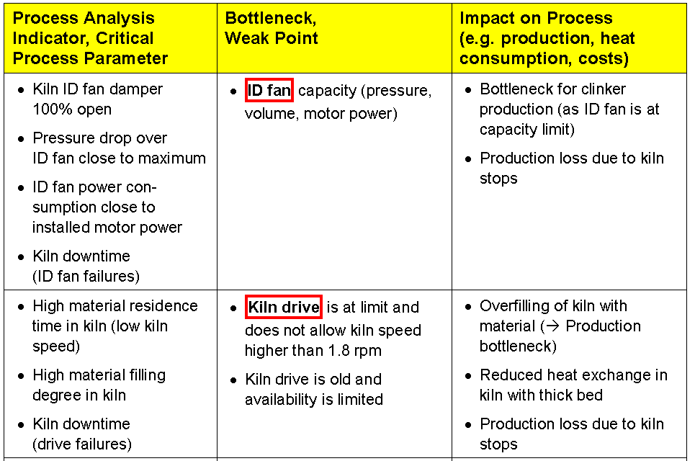
Bottlenecks and Weak Points - Year 1
19

Slide 20
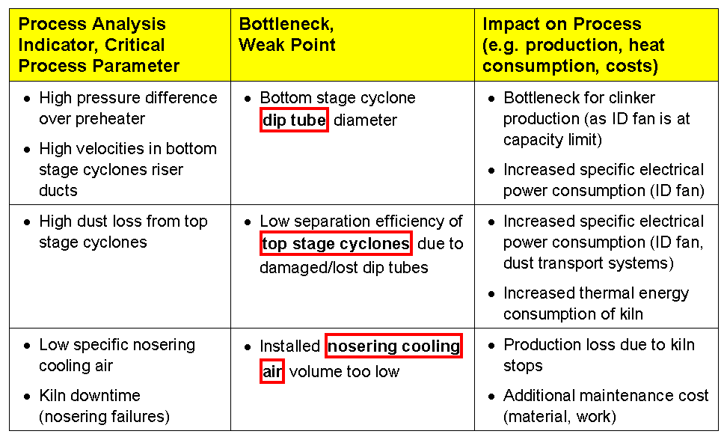
Bottlenecks and Weak Points - Year 1 (cont.)
20

Slide 21
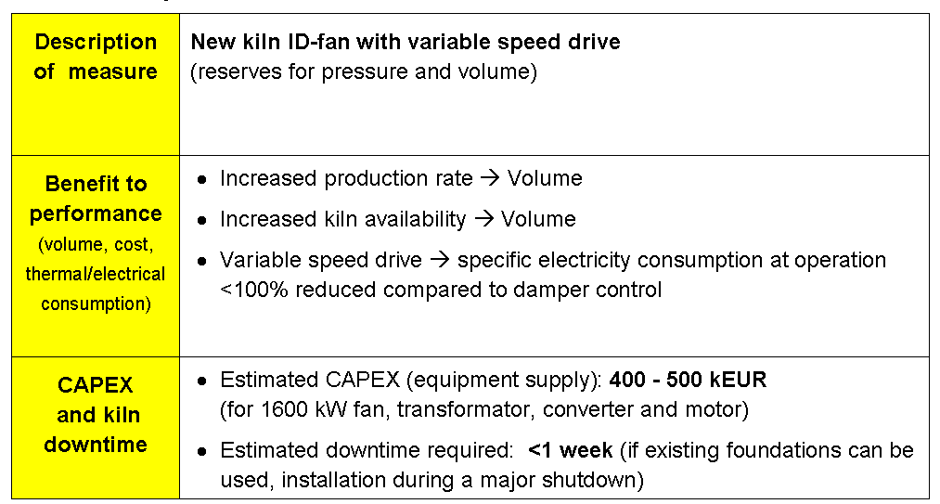
Year 1 - Improvement Measure # 1
21

Slide 22
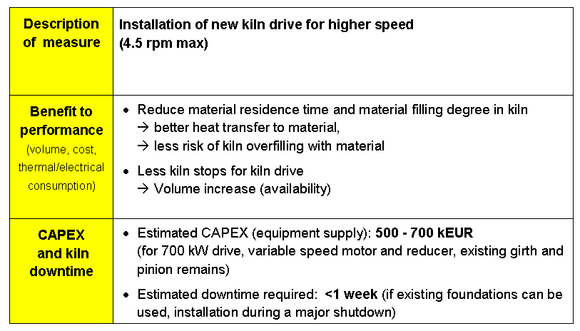
Year 1 - Improvement Measure # 2
22

Slide 23
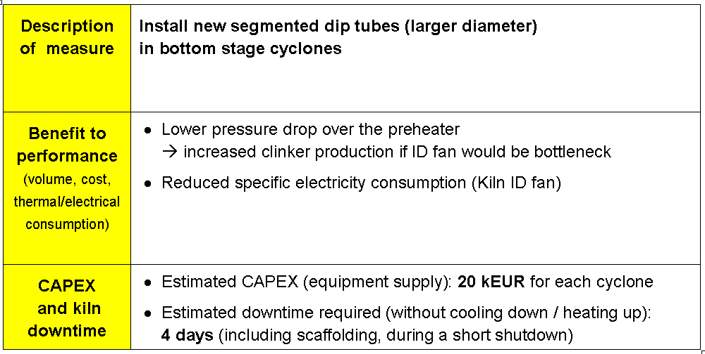
Year 1 - Improvement Measure # 3
23

Slide 24
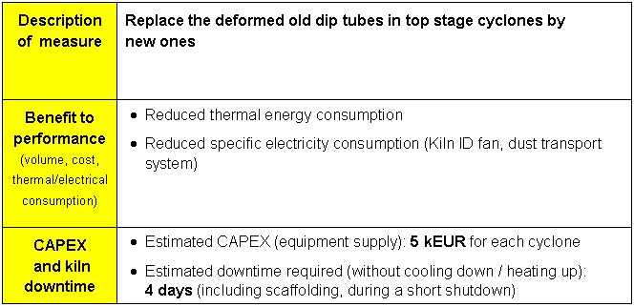
Year 1 - Improvement Measure # 4
24

Slide 25
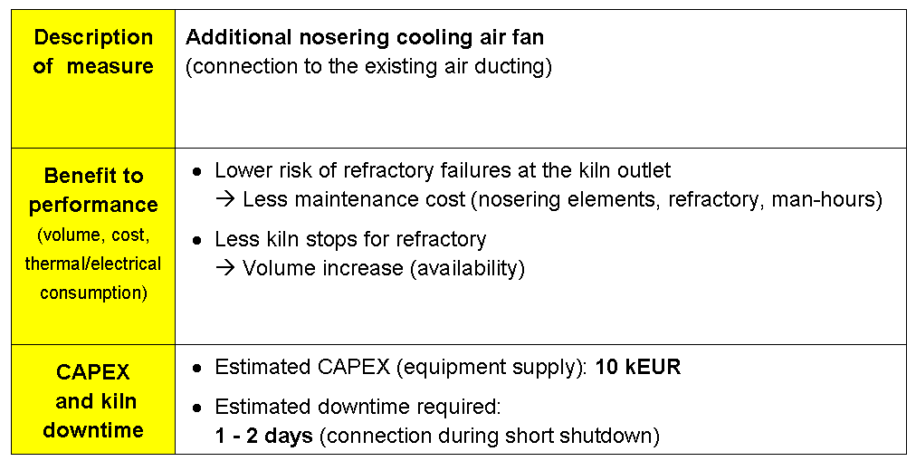
Year 1 - Improvement Measure # 5
25

Slide 26
Situation Production Year 2
All modifications decided in the previous year were implemented during shutdown in January
Realized modifications: new ID fan, new kiln drive, new dip tubes in bottom and top stage, nose ring cooling
Petroleum coke use started last year with first trials, currently around 15-30% substitution could be achieved.
Petcoke initiative identified potential of 75% petcoke substitution
Currently operation problems mainly in the calciner and kiln inlet when feeding more than 20% petcoke
Recently a new heat balance was done (see new handouts)
26

Slide 27
Key Performance Indicators of Year 2
27

Slide 28
Heat Balance Results for Year 2
28

Slide 29
Pareto Analysis Year 2
29

Slide 30
Production Target for Year 3
You as the PPE are in charge of proposing the right measures to achieve next year‘s targets:
Clinker production of 825’000 t/a (6.5% increase)
Kiln availability of 90%
Increase of petcoke / coal mass ratio to 75% / 25%
30

Slide 31
Task Description for Year 2
Calculate and assess relevant “Process Analysis Indicators” (e.g. kiln loads, critical velocities)
Assess the “Critical Process Parameters” (e.g pressures, temperatures) and Pareto diagram
Find the bottlenecks/weak points that are limiting clinker production
Propose the relevant improvement measures to reach the targets for the next year
31

Slide 32
Solution – Process Parameters for Year 2
Parameter | Value | Assessment, problems expected ?
Thermal burning zone load of kiln
Clinker cooler grate area load
Clinker cooler grate width load
Clinker cooling air installed
Clinker cooling air volume during heat balance
Which fan has highest deviation to the installed volume and why?
3.16 MW/m² O.K. (below 6 MW/m²)
35.1 t/d m² O.K. (below 45 t/d m²)
824 t/d m O.K. (below 1’500 t/d m)
1.79 Nm³/kg cli Low, 2.3 Nm³/kg cli is recommended for old coolers
1.68 Nm³/kg cli 6% below installed volume, mainly due to last fan
Fan #4 Volume deviation 9%, fan is at pressure limit (20 mbar installed)
32

Slide 33
Solution – Process Parameters for Year 2
Parameter | Value | Assessment, problems expected ?
Theoretically achievable clinker temperature (rule of thumb)
Specific secondary air volume
Specific tertiary air volume (approximated)
Air velocity at kiln hood
Air velocity in tertiary air duct
180 °C Actual (214 °C) is too high, reduced efficiency
0.374 Nm³/kg cli
0.494 Nm³/kg cli
6.6 m/s Elevated dust entrainment possible (limit for existing kilns is 6 m/s)
28.4 m/s O.K. (above 25 m/s)
33

Slide 34
Solution – Process Parameters for Year 2
Parameter | Value | Assessment, problems expected ?
Relative false air intake in stage 2 (2nd lowest cyclone)
Required fineness of coal / petcoke mix (%R 90 μm)
Gas residence time in precalciner
Sulfur volatility in kiln
8.4 % False air increased; normal is 1-2 % per stage
11.7 % Actual residue of 19 % is too high → combustion problems
2.4 s Low, especially for petcoke; recommended is > 4.5 s
0.80 High; >0.7 indicates combustion problems
34

Slide 35
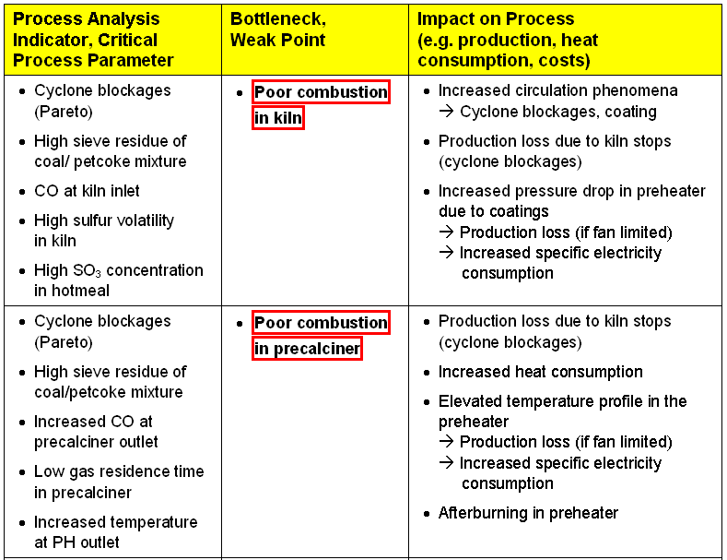
Bottlenecks and Weak Points - Year 2
35

Slide 36
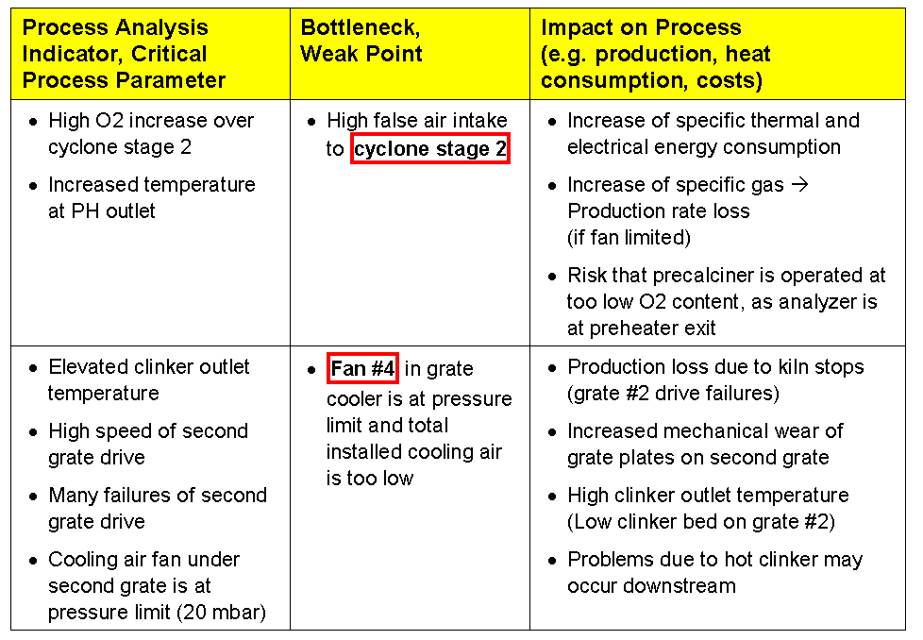
Bottlenecks and Weak Points - Year 2 (cont.)
36

Slide 37
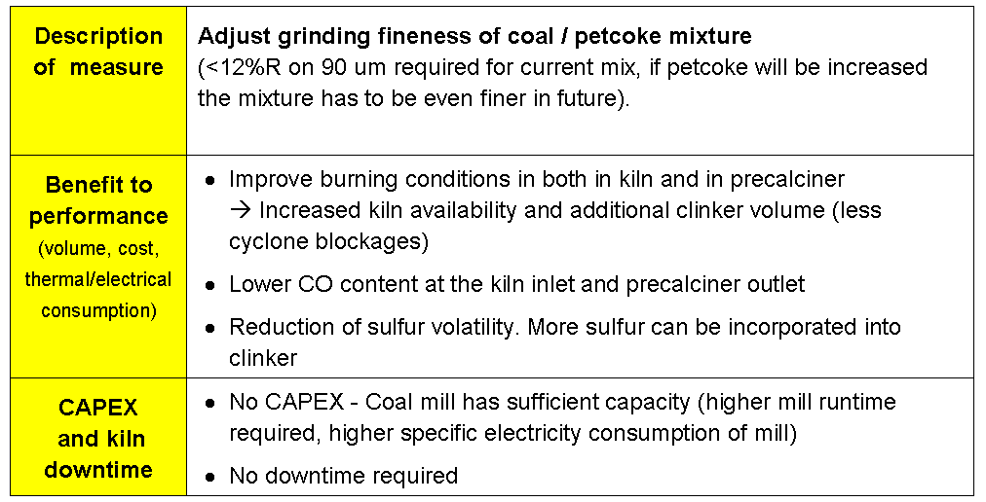
Year 2 - Improvement Measure # 1
37

Slide 38
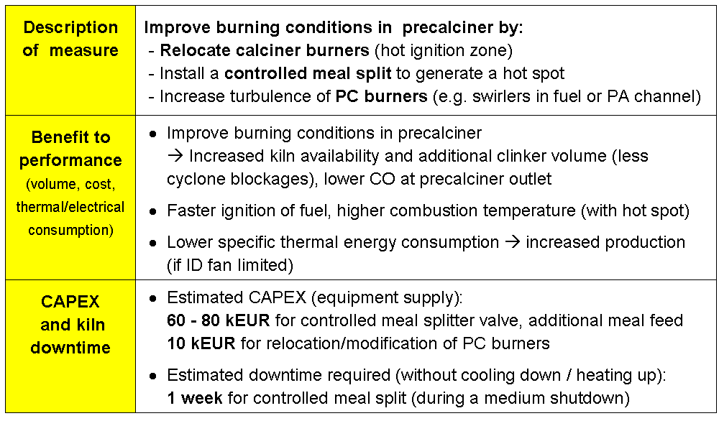
Year 2 - Improvement Measure # 2
38

Slide 39
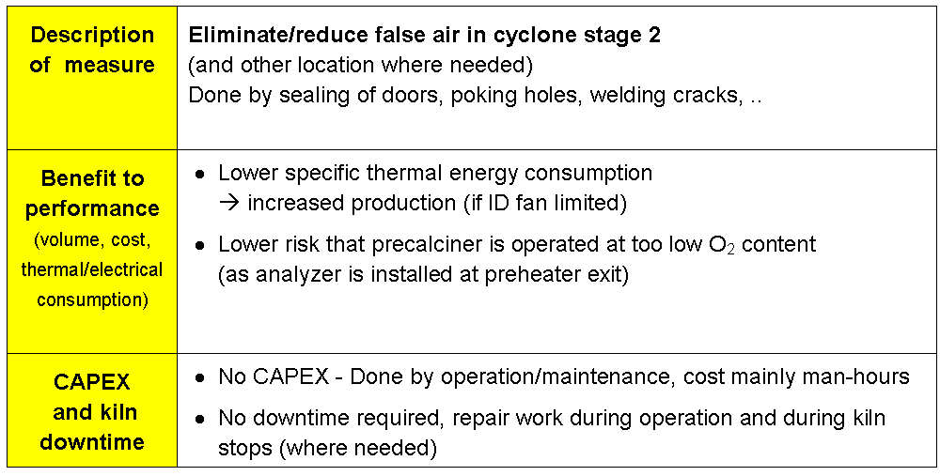
Year 2 - Improvement Measure # 3
39

Slide 40
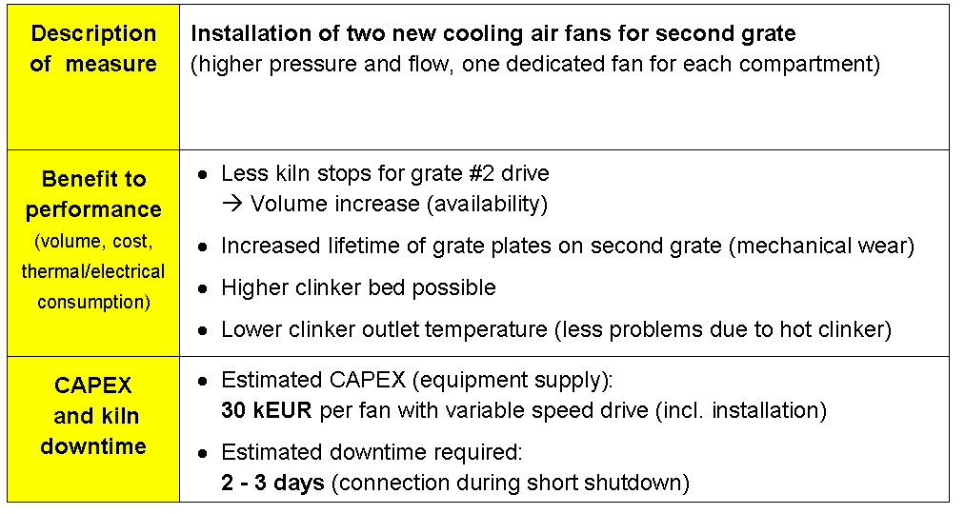
Year 2 - Improvement Measure # 4
40

